Slide 1




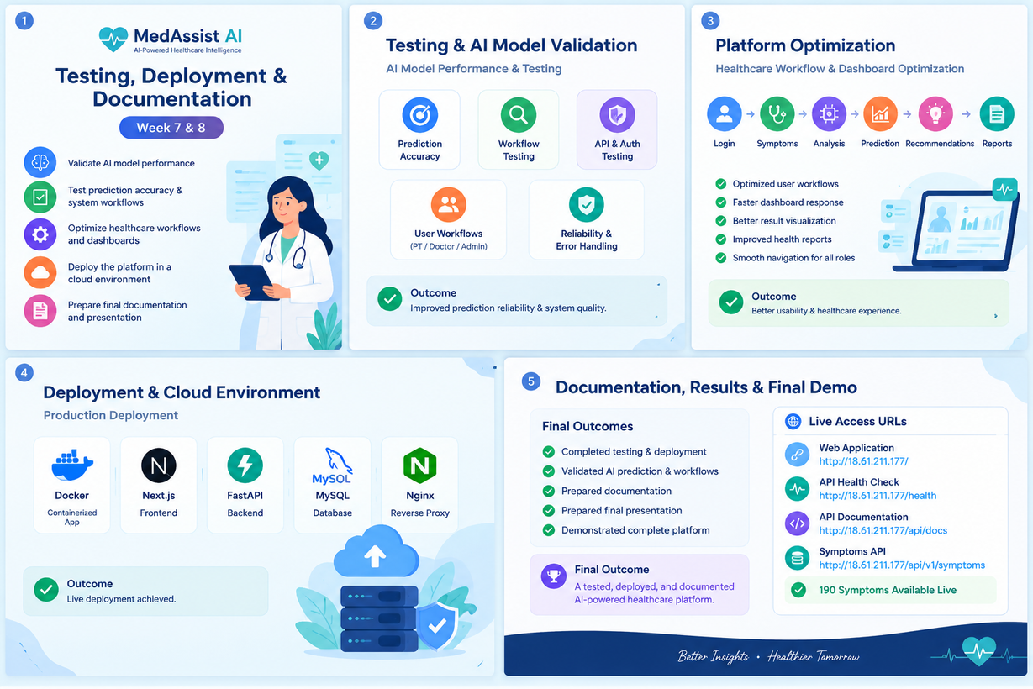


Medical Symptom Analysis & Disease Prediction System

Slide 2


Testing, Deployment & Documentation
 |  | Validate AI model performance Test prediction accuracy and system workflows Optimize healthcare workflows and dashboards Deploy the platform in a cloud environment Prepare final documentation and presentation
Testing & AI Model Validation
AI Model Performance & Testing
Validated disease prediction accuracy
Tested symptom analysis and prediction workflows
Performed API and authentication testing
Verified patient, doctor, and admin workflows
Checked system reliability and error handling
Outcome: Improved prediction reliability and system quality.

Slide 3


Platform Optimization
Healthcare Workflow & Dashboard Optimization
Workflow:
Login → Symptoms → Analysis → Prediction → Recommendations → Reports
Optimized user workflows
Improved dashboard responsiveness
Enhanced prediction result visualization
Improved recommendations and health reports
Verified smooth navigation across user roles
Outcome: Better usability and healthcare experience.

Slide 4


Deployment & Cloud Environment
Production Deployment
Containerized application using Docker
Deployed Next.js frontend
Deployed FastAPI backend
Configured MySQL database
Configured Nginx reverse proxy
Tested live API and frontend connectivity
Outcome: Successfully achieved a live working deployment.
Documentation, Results & Final Demo
Final Outcomes
Completed Milestone 4 testing and deployment
Validated AI prediction and platform workflows
Prepared project documentation
Prepared final presentation and demonstration
Demonstrated complete MedAssist AI platform
Final Outcome
A tested, deployed, and documented AI-powered healthcare platform ready for final demonstration.

Slide 5

Deployment Results & Live Access
MedAssist AI — Live Deployment
✅ Web Application: http://18.61.211.177/
✅ API Health Check: http://18.61.211.177/health
✅ Interactive API Docs: http://18.61.211.177/api/docs
✅ Symptoms API: http://18.61.211.177/api/v1/symptoms
✅ 190 Symptoms Available Live

